Slide 2

Study on Deep-Sea Fish Detection Using Convolutional Neural Networks (CNNs)
Presentation - 4
CSC-695 Directed Study
Under the Guidance of
Dr. Joe Zhang
By:
Poojitha Priyadarshini Madari
April 09 2025

Slide 3

Contents
Introduction
Problem Statement
Dataset
Model Selection and Training
Model Evaluation and Results
Visualization
Objectives
Methodology
Challenges
Conclusion and Future Enhancements
Literature Review
Requirements

Slide 4
INTRODUCTION
Automated fish detection is critical for marine conservation, sustainable fisheries, and ecological monitoring.
Traditional methods are
Manual
Time-consuming
Error-prone
Deep learning (DL) revolutionizes underwater image analysis but faces challenges like turbidity, occlusion, and class imbalance.
Saleh, Alzayat, Marcus Sheaves, and Mostafa Rahimi Azghadi. "Computer vision and deep learning for fish classification in underwater habitats: A survey." Fish and Fisheries 23.4 (2022): 977-999. - small size, moderate Size and Large sized including grey scale fish Dataset.

Slide 5
INTRODUCTION
YOLO-Fish :
A robust YOLOv5-based model designed for realistic underwater environments.
Addresses key challenges: low light, turbidity, small targets, and real-time deployment.
Multajam, Rizki, et al. "Real-time detection and classification of fish in underwater environment using YOLOv5: a comparative study of deep learning architectures." Informatyka, Automatyka, Pomiary w Gospodarce i Ochronie Środowiska 14 (2024).

Slide 6
PROBLEM STATEMENT
Low accuracy of generic DL models in underwater conditions (e.g., Faster R-CNN: 72.1% mAP).
High computational cost limits real-time deployment on edge devices.
Class imbalance and rare species misclassification.
YOLO-Fish Focus:
Improve detection in turbid water, occluded scenes, and low-light conditions while maintaining real-time performance.
Saleh, Alzayat, Marcus Sheaves, and Mostafa Rahimi Azghadi. "Computer vision and deep learning for fish classification in underwater habitats: A survey." Fish and Fisheries 23.4 (2022): 977-999. - small size, moderate Size and Large sized including grey scale fish Dataset.
Al Muksit, Abdullah, et al. "YOLO-Fish: A robust fish detection model to detect fish in realistic underwater environment." Ecological Informatics 72 (2022): 101847. Deepfish dataset, Ozfish Dataset and Mixed Dataset. Yolo Fish-1 & Yolo Fish-2 models

Slide 7
OBJECTIVES
Develop Optimized YOLOv5 Variant
Tailored for underwater conditions:
Turbidity, lighting issues, fish occlusion
Use domain-specific augmentations and anchor tuning
Achieve High Accuracy (mAP@0.5 > 80%) – Mean Average Precision
mAP@0.5 = Mean Average Precision at IoU threshold of 0.5
IoU (Intersection over Union):
Measures how much the predicted box overlaps with the actual object box
IoU ≥ 0.5 → considered a correct detection
Multajam, Rizki, et al. "Real-time detection and classification of fish in underwater environment using YOLOv5: a comparative study of deep learning architectures." Informatyka, Automatyka, Pomiary w Gospodarce i Ochronie Środowiska 14 (2024).

Slide 8
OBJECTIVES
Enable Real-Time Inference (≥30 FPS) – Frame Per Second
Optimize for edge devices (e.g., Jetson AGX Xavier)
Techniques:
Model pruning
Quantization (FP16/INT8)
Use lightweight variants (e.g., YOLOv5n)
Handle Class Imbalance Effectively
Apply hybrid sampling to balance dataset
Use hybrid loss functions

Slide 9
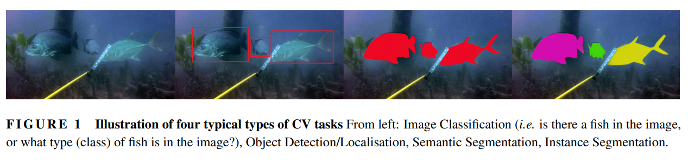
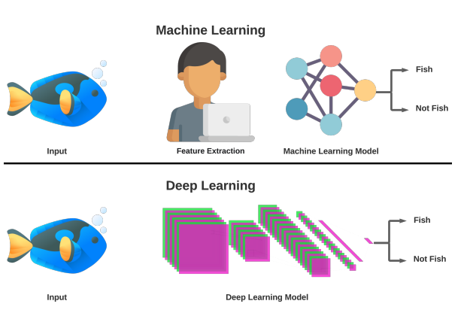
Illustration of four typical types of CV tasks: From Left – Image Classification (Fish – yes or no); Object Detection/ Localization, Semantic Segmentation, Instance Segmentation
Saleh, Alzayat, Marcus Sheaves, and Mostafa Rahimi Azghadi. "Computer vision and deep learning for fish classification in underwater habitats: A survey." Fish and Fisheries 23.4 (2022): 977-999. - small size, moderate Size and Large sized including grey scale fish Dataset.

Slide 10
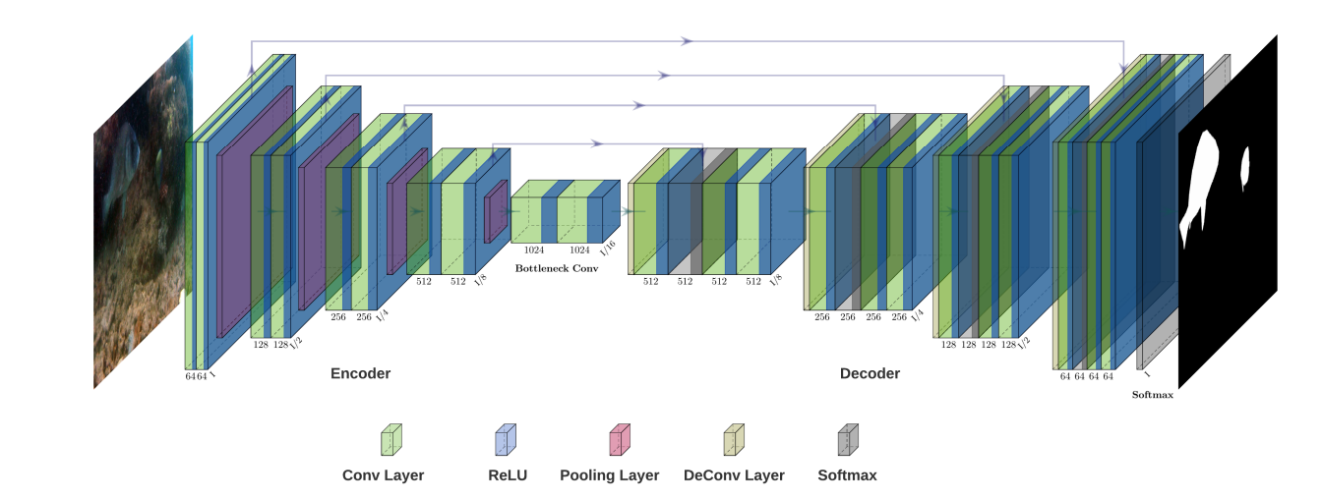
LITERATURE REVIEW
Deep-learning Application for the Fish Identification
Saleh, Alzayat, Marcus Sheaves, and Mostafa Rahimi Azghadi. "Computer vision and deep learning for fish classification in underwater habitats: A survey." Fish and Fisheries 23.4 (2022): 977-999. - small size, moderate Size and Large sized including grey scale fish Dataset.

Slide 11
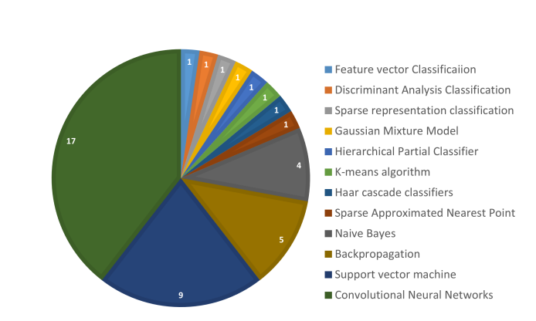
An overview of the methods used for ﬁsh classiﬁcation using different Computer Vision techniques from 2003 to 2021. It is evident from the graph that DL andi ts CNNs have attracted more attention than classical ML methods
Saleh, Alzayat, Marcus Sheaves, and Mostafa Rahimi Azghadi. "Computer vision and deep learning for fish classification in underwater habitats: A survey." Fish and Fisheries 23.4 (2022): 977-999. - small size, moderate Size and Large sized including grey scale fish Dataset.

Slide 12
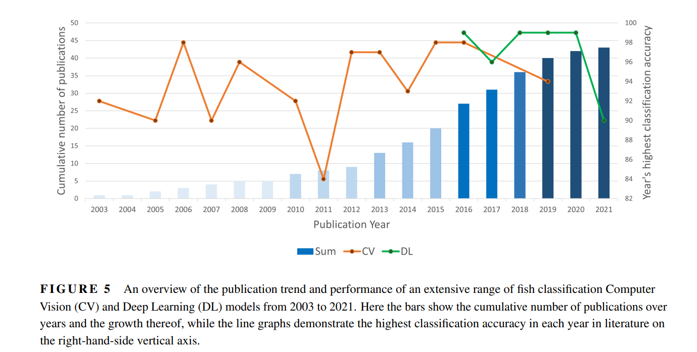
Saleh, Alzayat, Marcus Sheaves, and Mostafa Rahimi Azghadi. "Computer vision and deep learning for fish classification in underwater habitats: A survey." Fish and Fisheries 23.4 (2022): 977-999. - small size, moderate Size and Large sized including grey scale fish Dataset.

Slide 13
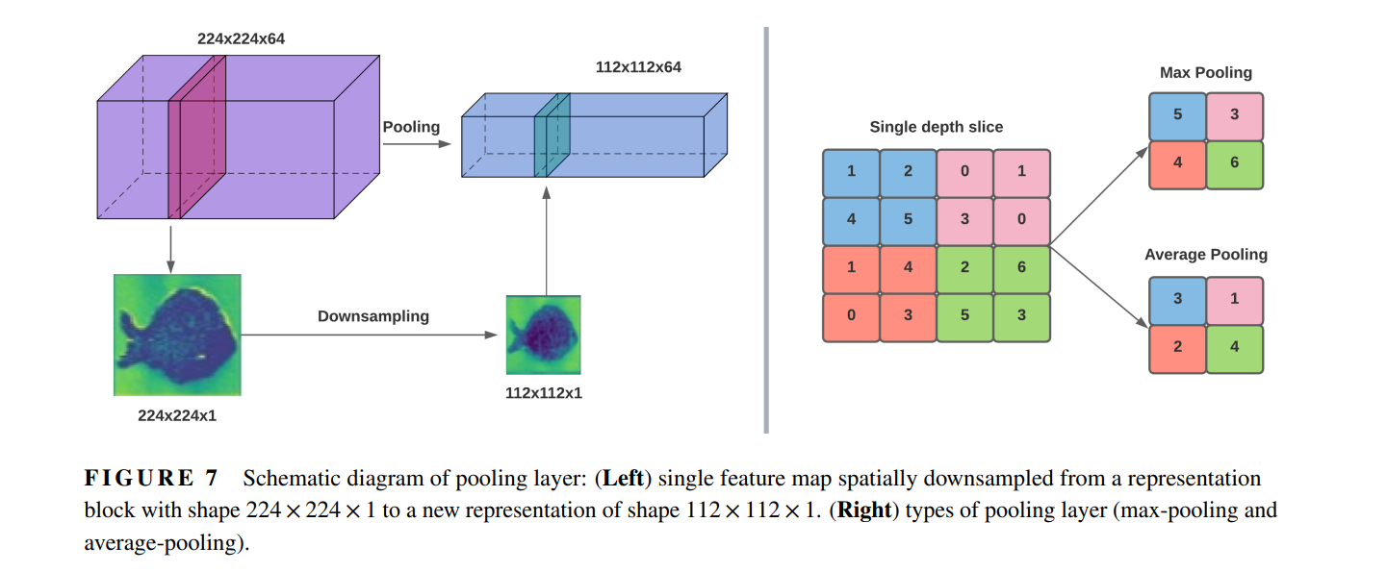
Saleh, Alzayat, Marcus Sheaves, and Mostafa Rahimi Azghadi. "Computer vision and deep learning for fish classification in underwater habitats: A survey." Fish and Fisheries 23.4 (2022): 977-999. - small size, moderate Size and Large sized including grey scale fish Dataset.

Slide 14
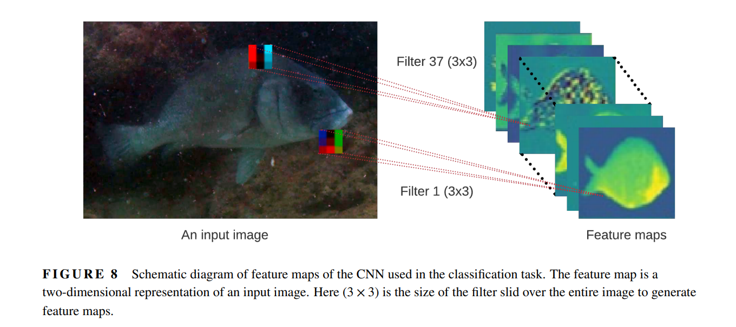
Al Muksit, Abdullah, et al. "YOLO-Fish: A robust fish detection model to detect fish in realistic underwater environment." Ecological Informatics 72 (2022): 101847.

Slide 15
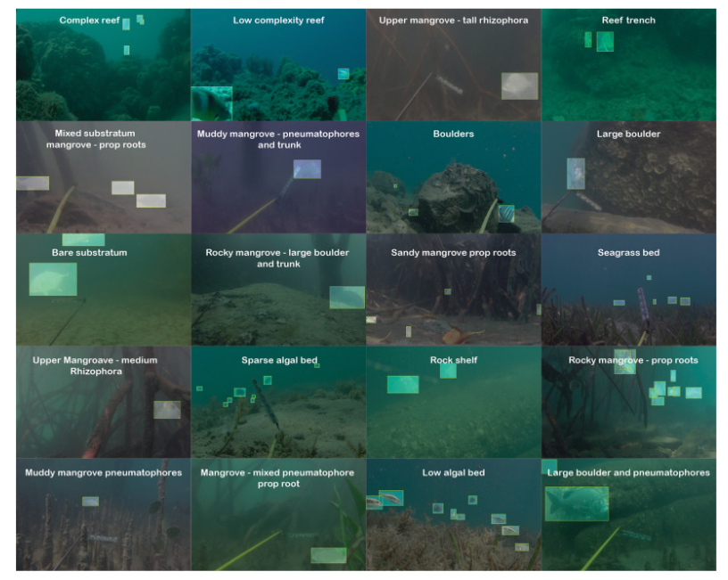
Al Muksit, Abdullah, et al. "YOLO-Fish: A robust fish detection model to detect fish in realistic underwater environment." Ecological Informatics 72 (2022): 101847.

Slide 16
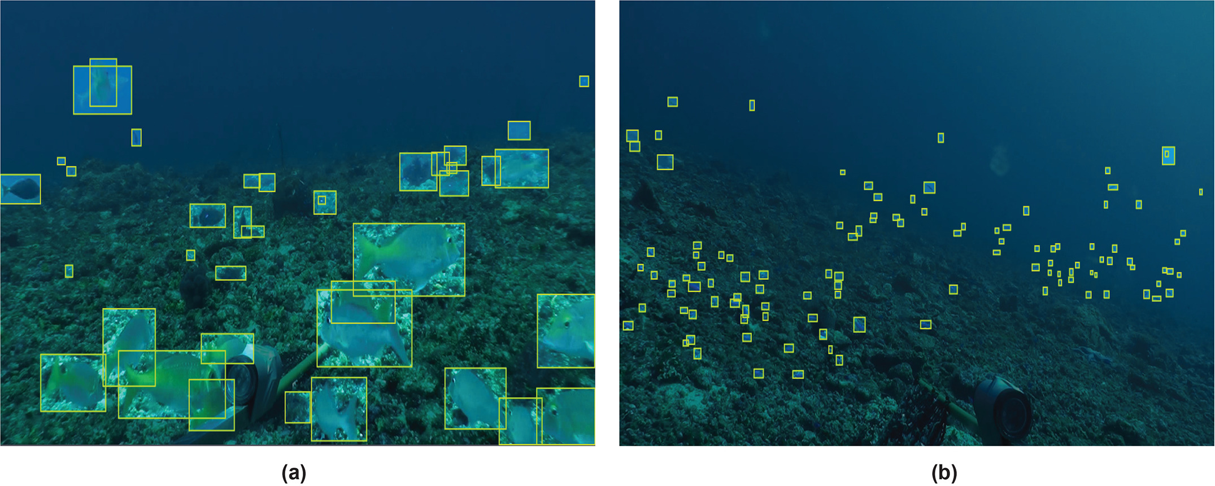
Al Muksit, Abdullah, et al. "YOLO-Fish: A robust fish detection model to detect fish in realistic underwater environment." Ecological Informatics 72 (2022): 101847.

Slide 17
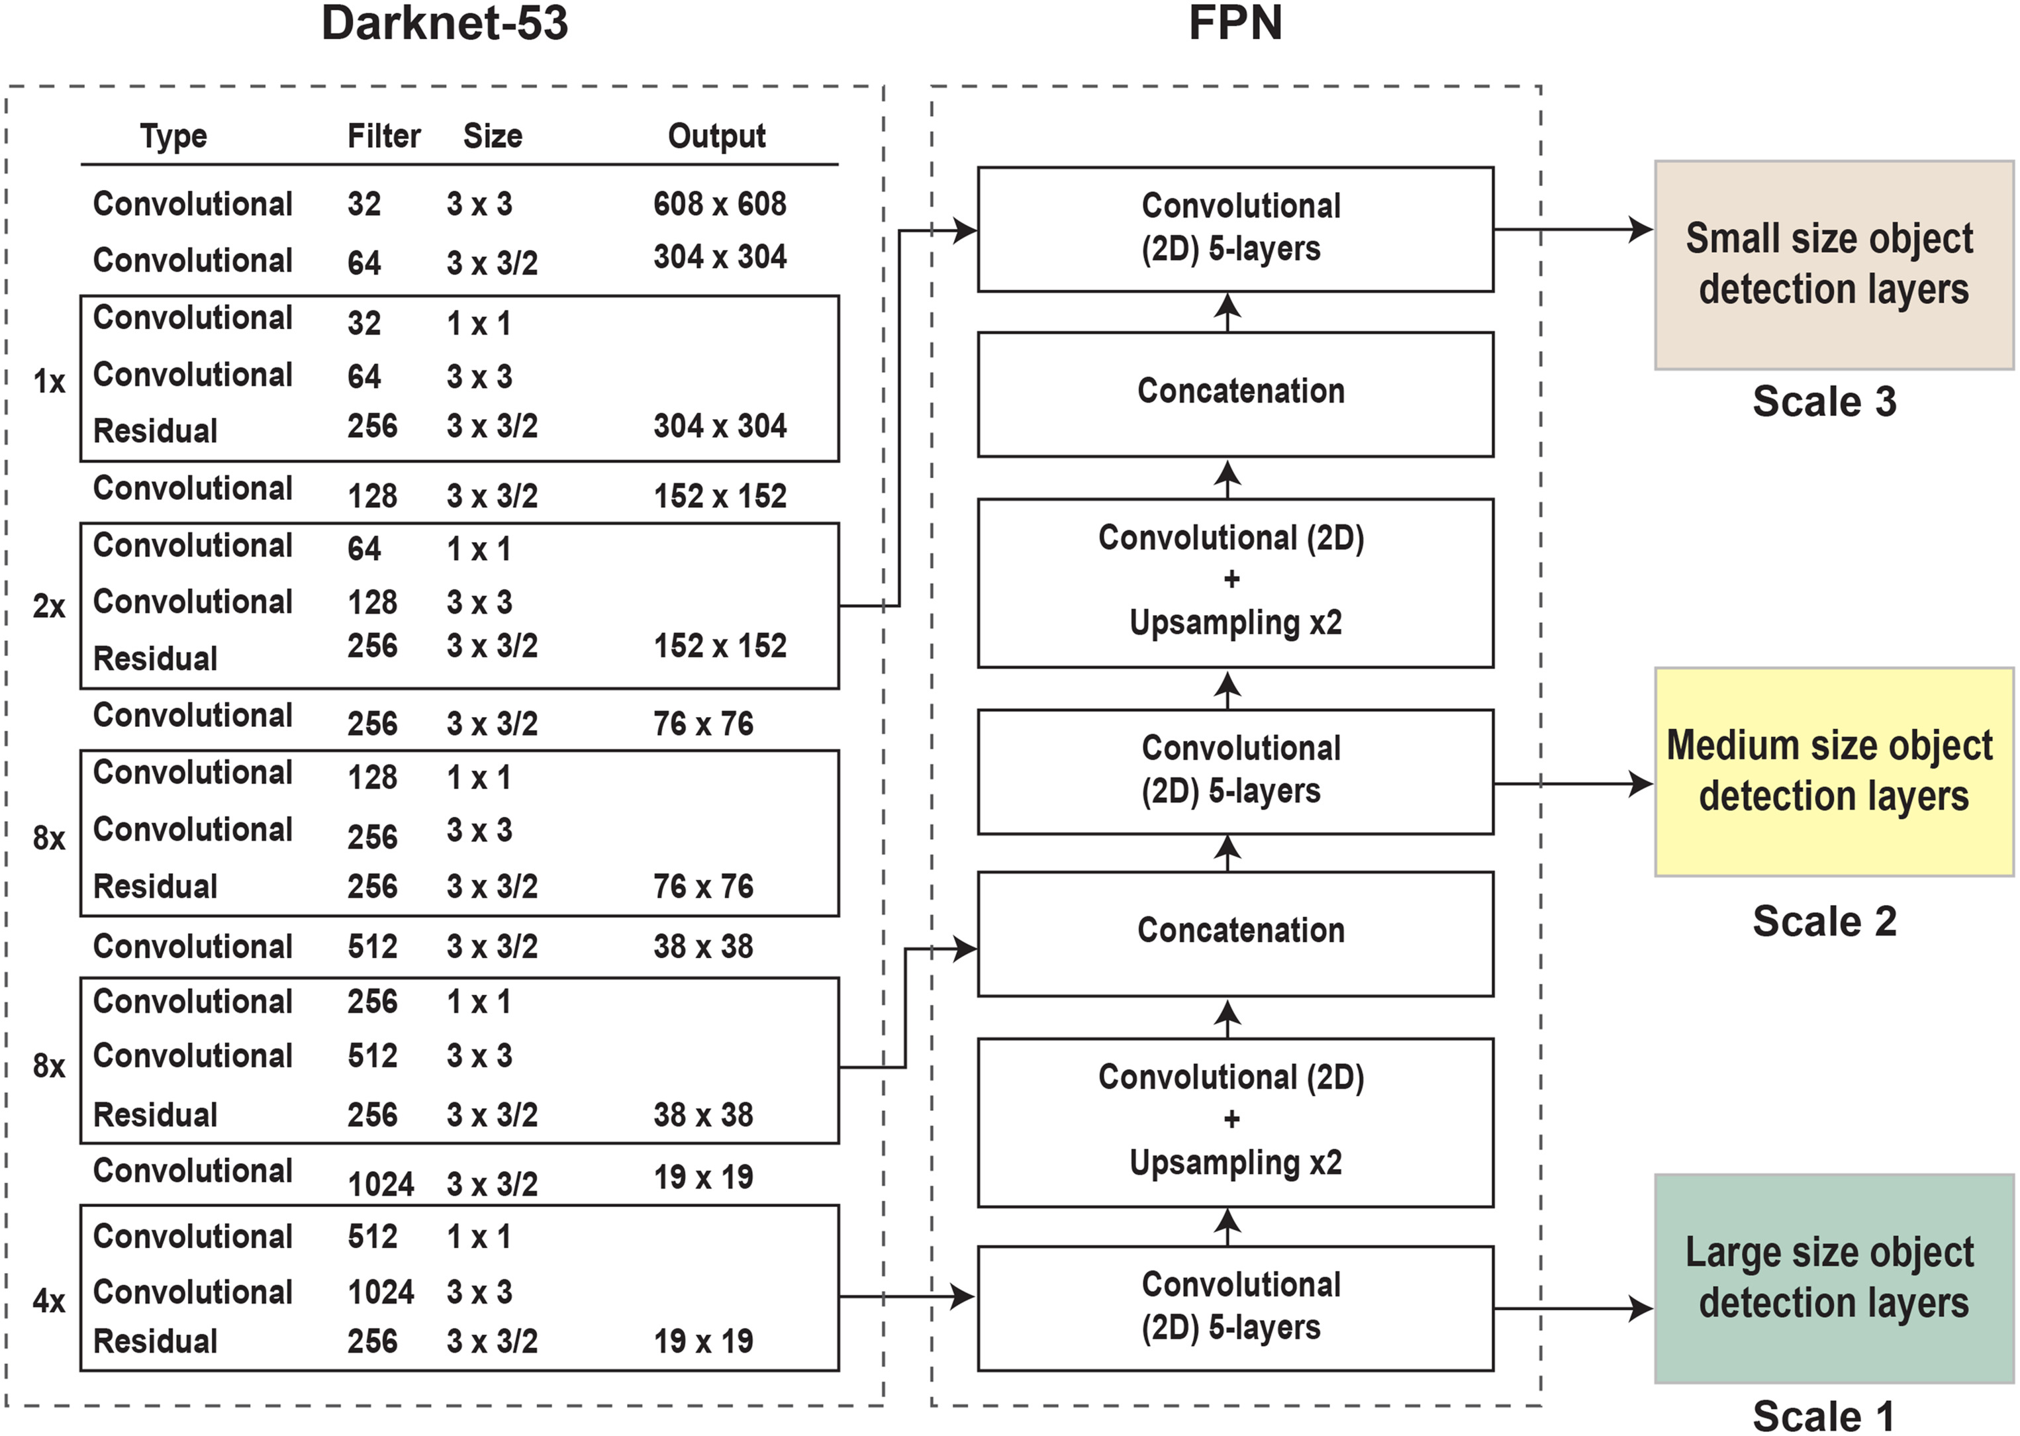
YOLO v3- Backbone Darknet and Feature Pyramid Network – FPN with three heads
Al Muksit, Abdullah, et al. "YOLO-Fish: A robust fish detection model to detect fish in realistic underwater environment." Ecological Informatics 72 (2022): 101847.

Slide 18
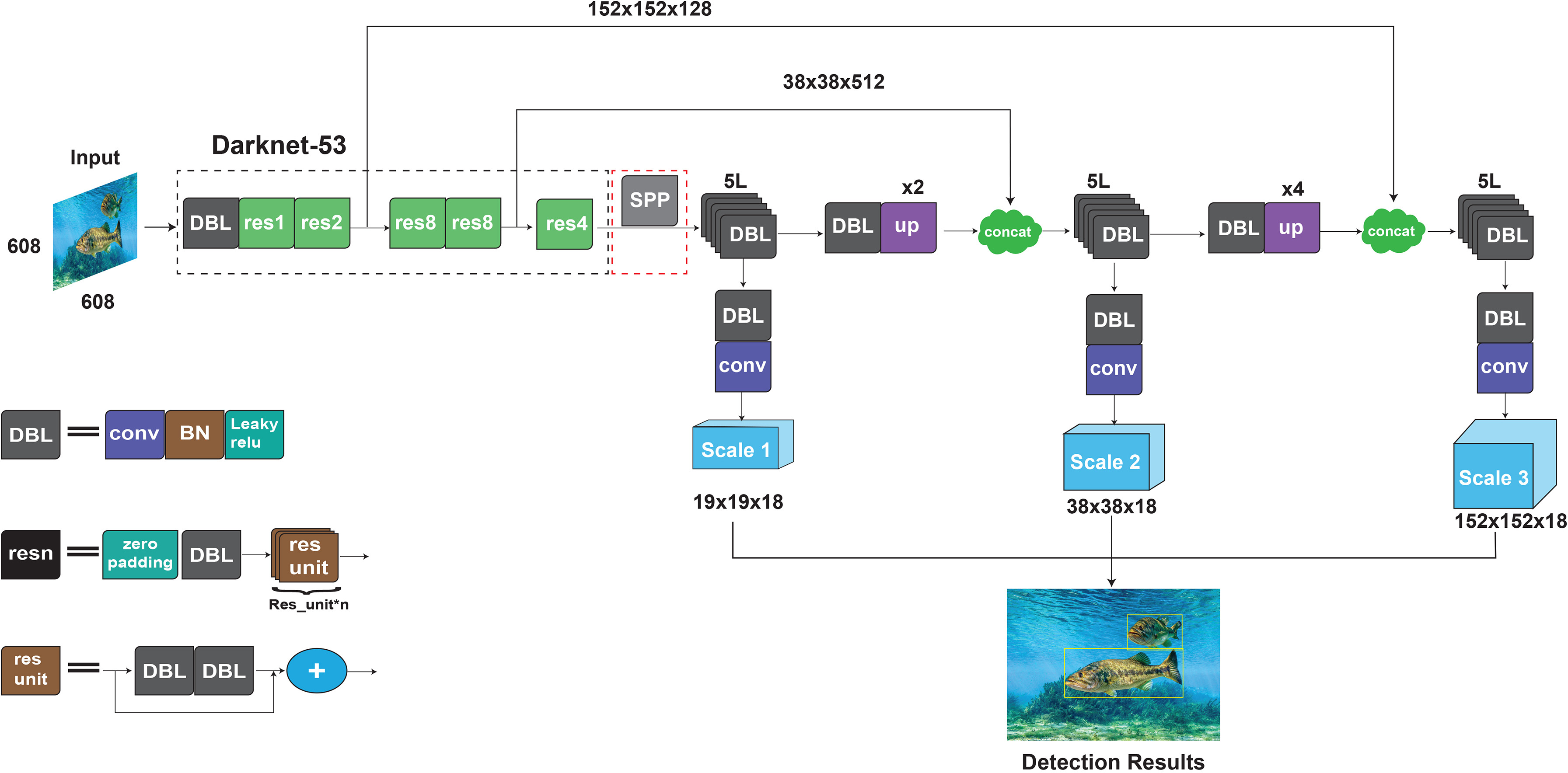
YOLO Fish-1 Model
Al Muksit, Abdullah, et al. "YOLO-Fish: A robust fish detection model to detect fish in realistic underwater environment." Ecological Informatics 72 (2022): 101847.

Slide 19
Optimize upsample step size in YOLO-Fish-1 to better detect tiny objects in custom dataset.
Component | Details
Challenge | Small objects become hard to detect after image resizing (e.g., to 416×416).
Standard YOLOv3 | Uses upsampling by a factor of 2 – may not retain enough small object features.
Our Custom Dataset | Contains many tiny objects that shrink significantly after resizing.
Modification | Increased upsample step size from 2 to 4 for better resolution recovery.
Result | Better preservation of small object features in feature maps.
Al Muksit, Abdullah, et al. "YOLO-Fish: A robust fish detection model to detect fish in realistic underwater environment." Ecological Informatics 72 (2022): 101847.

Slide 20
Key Enhancements in YOLO-Fish-1:
Upsample x4 feature map to improve resolution.
Merge upsampled features with 2nd residual block of Darknet-53.
Create additional detection layer at scale 3 for small object detection.
Outcome: Improved detection performance on small and low-resolution targets by refining the multi-scale detection pipeline.
Feature Map Fusion | Dimensions
Modified upsampling output | From ↓ to ↑
Feature map from 2nd residual block | 152×152×128
Final merged feature map | Concatenated for enhanced feature learning
Al Muksit, Abdullah, et al. "YOLO-Fish: A robust fish detection model to detect fish in realistic underwater environment." Ecological Informatics 72 (2022): 101847.

Slide 21
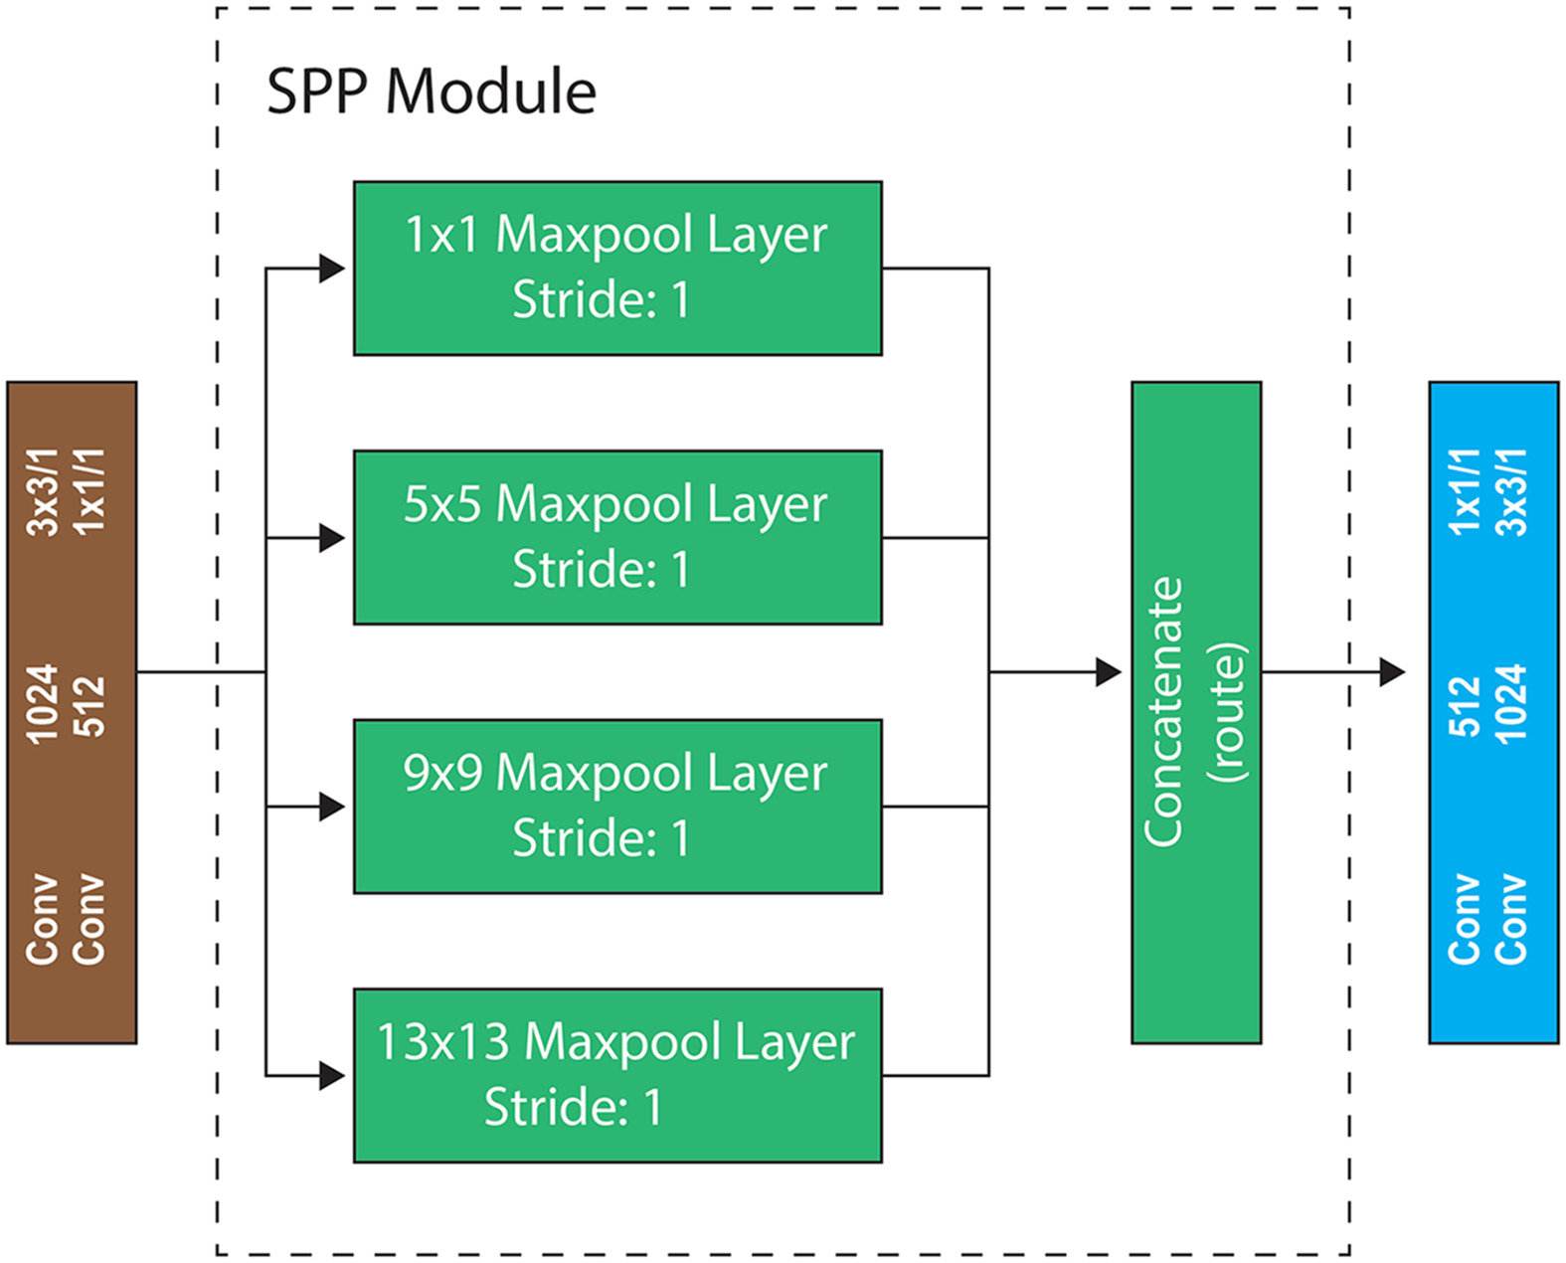
YOLO Fish-2 Model – Spatial Pyramid Pooling
Al Muksit, Abdullah, et al. "YOLO-Fish: A robust fish detection model to detect fish in realistic underwater environment." Ecological Informatics 72 (2022): 101847.

Slide 22
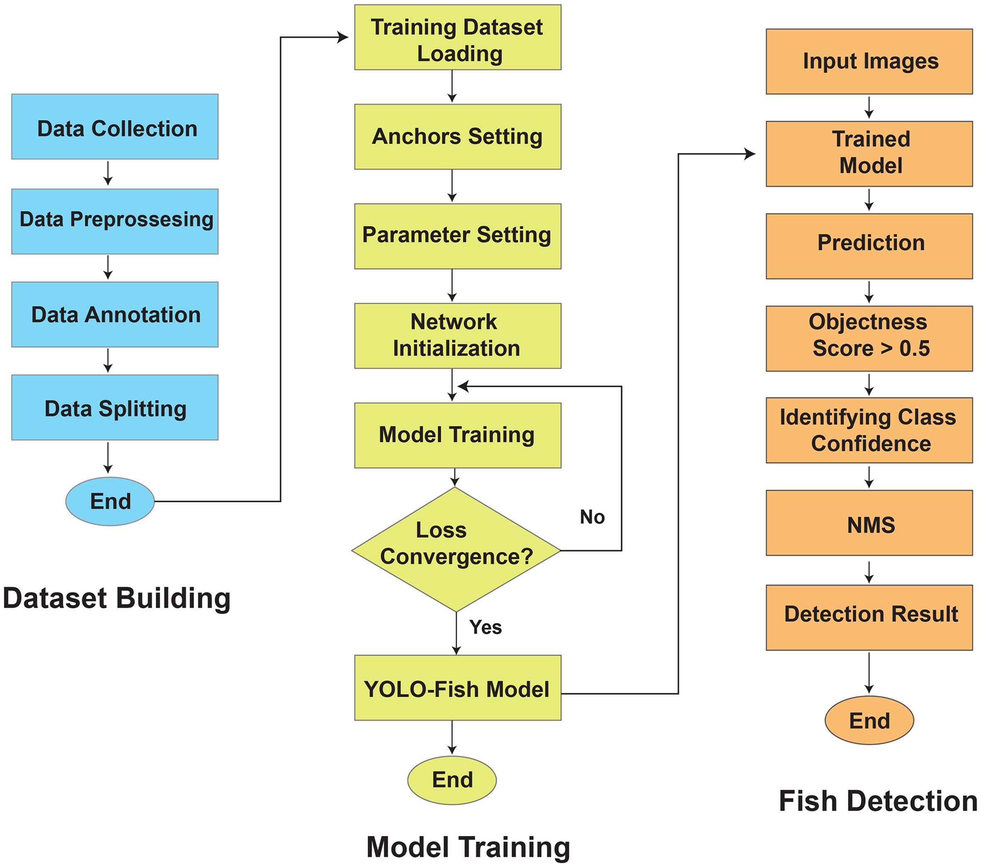
YOLO Model Setup
Al Muksit, Abdullah, et al. "YOLO-Fish: A robust fish detection model to detect fish in realistic underwater environment." Ecological Informatics 72 (2022): 101847.

Slide 23
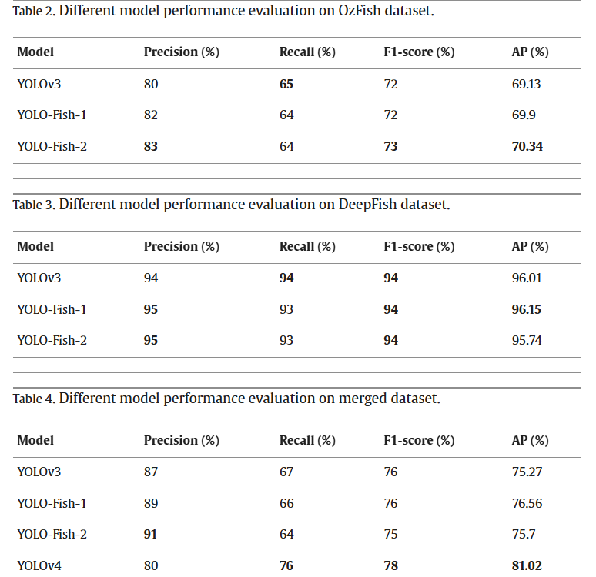
Al Muksit, Abdullah, et al. "YOLO-Fish: A robust fish detection model to detect fish in realistic underwater environment." Ecological Informatics 72 (2022): 101847.

Slide 24
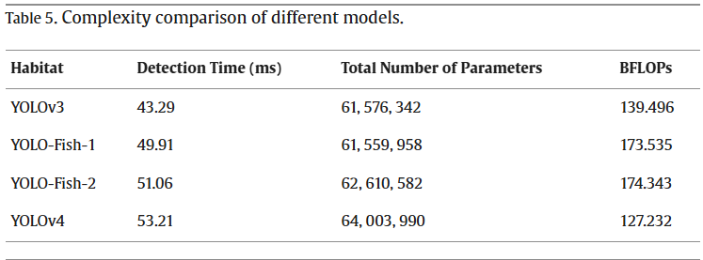
Billion floating-point operations per second (BFLOPs)
Al Muksit, Abdullah, et al. "YOLO-Fish: A robust fish detection model to detect fish in realistic underwater environment." Ecological Informatics 72 (2022): 101847.

Slide 25
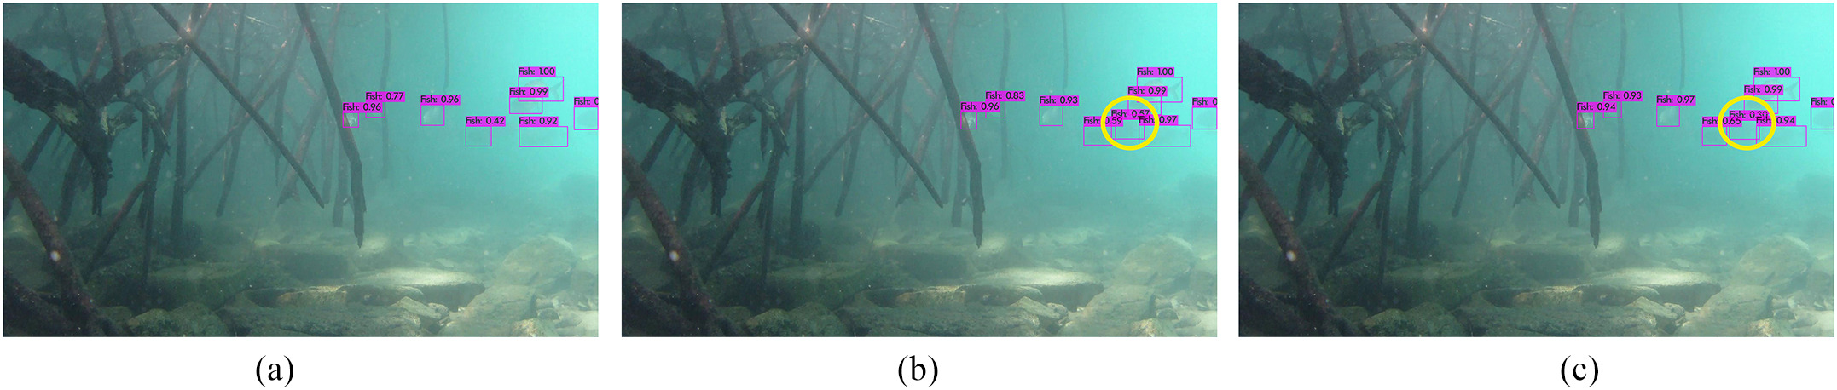
Comparison of YOLO-Fish models for
YOLOv3
YOLO-Fish-1
YOLO-Fish-2
Detection results on a DeepFish image.
Al Muksit, Abdullah, et al. "YOLO-Fish: A robust fish detection model to detect fish in realistic underwater environment." Ecological Informatics 72 (2022): 101847.

Slide 26
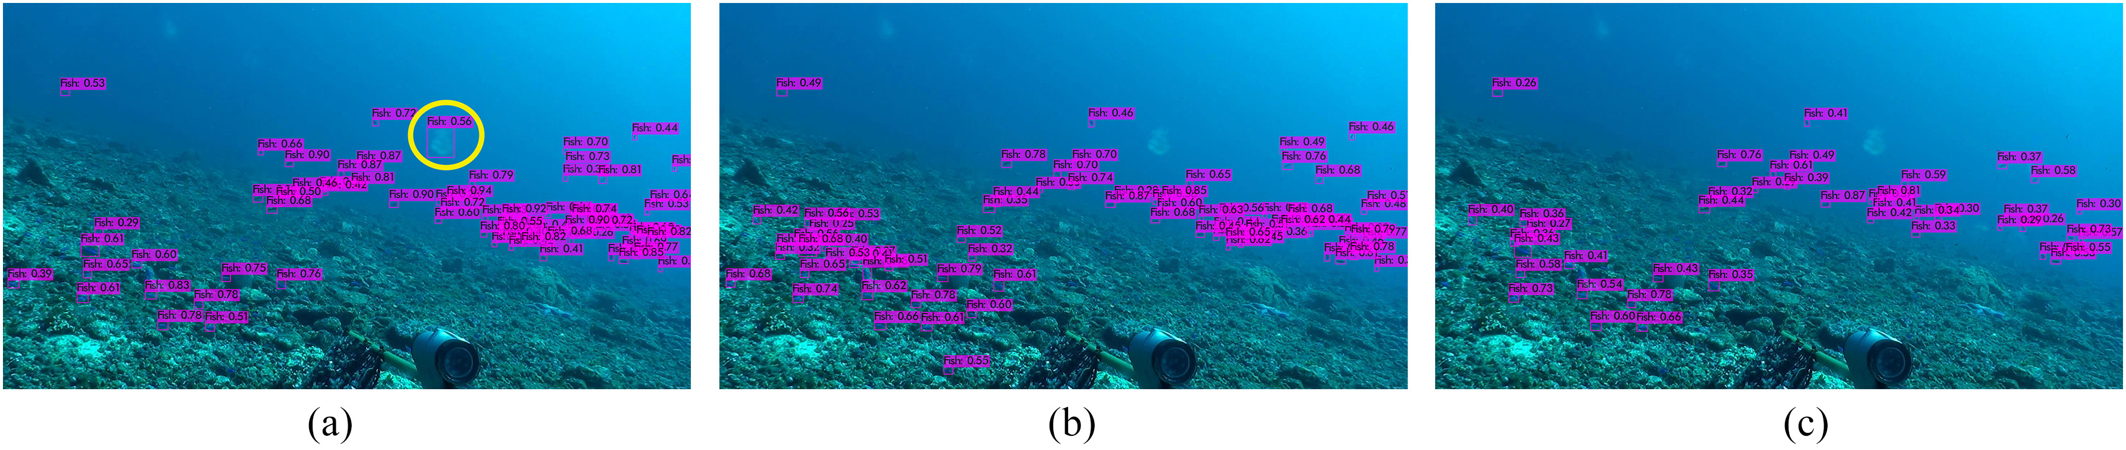
Comparison of YOLO-Fish models for
YOLOv3
YOLO-Fish-1
YOLO-Fish-2
Detection results on a OzFish image
Al Muksit, Abdullah, et al. "YOLO-Fish: A robust fish detection model to detect fish in realistic underwater environment." Ecological Informatics 72 (2022): 101847.

Slide 27
https://github.com/alzayats/DeepFish
Category | Dataset/Method | Details
Primary Dataset | DeepFish | 7,339 images, 20 Environments
Secondary Datasets | DeepFish and OzFish | Yolo Fish – 1 and Yolo Fish- 2
Sample Dataset | Goldfish and Koi Fish | Random Samples (~10)
 | Custom Turbid/Occluded Data | Synthetic augmentation
Preprocessing | CLAHE | Contrast enhancement
 | Wavelet Denoising | Speckle noise reduction
DATASET
Multajam, Rizki, et al. "Real-time detection and classification of fish in underwater environment using YOLOv5: a comparative study of deep learning architectures." Informatyka, Automatyka, Pomiary w Gospodarce i Ochronie Środowiska 14 (2024). – Goldfish,koi fish dataset with Random Samples
Saleh, Alzayat, Marcus Sheaves, and Mostafa Rahimi Azghadi. "Computer vision and deep learning for fish classification in underwater habitats: A survey." Fish and Fisheries 23.4 (2022): 977-999. - small size, moderate Size and Large sized including grey scale fish Dataset.
Al Muksit, Abdullah, et al. "YOLO-Fish: A robust fish detection model to detect fish in realistic underwater environment." Ecological Informatics 72 (2022): 101847. Deepfish dataset, Ozfish Dataset and Mixed Dataset. Yolo Fish-1 & Yolo Fish-2 models

Slide 28
REQUIREMENTS
1080-pixel HD camera
An Intel Core i3 processor
Python 3.9
Multajam, Rizki, et al. "Real-time detection and classification of fish in underwater environment using YOLOv5: a comparative study of deep learning architectures." Informatyka, Automatyka, Pomiary w Gospodarce i Ochronie Środowiska 14 (2024). – Goldfish,koi fish dataset with Random Samples

Slide 29
METHODOLOGY
YOLO-Fish Innovations :
Hybrid Backbone: CSP2 Module + SE Attention for richer feature extraction and focus on fish regions.
BiFPN-Lite Neck: Lightweight multi-scale feature fusion to improve small-target recall (~10% gain).
NWD-IoU Loss: Combines Wasserstein distance with IoU for better bounding box localization (~4% improvement).IoU – Intersection of unions
Dynamic Anchors: Multi-scale anchor system adapts to diverse fish sizes (~3% mAP gain).
Multajam, Rizki, et al. "Real-time detection and classification of fish in underwater environment using YOLOv5: a comparative study of deep learning architectures." Informatyka, Automatyka, Pomiary w Gospodarce i Ochronie Środowiska 14 (2024).

Slide 30
Hybrid Backbone: CSP2 Module + SE Attention
CSP2 (Cross Stage Partial Network): Efficiently splits feature maps into two parts – one goes through residual layers, and one bypasses – and then merges them. This reduces computation while retaining strong features.
SE Attention (Squeeze-and-Excitation): Focuses the model’s attention on important features, like fish regions, by reweighting channel-wise information.
Benefit:
Richer, more focused features, especially useful in cluttered or underwater environments.
Multajam, Rizki, et al. "Real-time detection and classification of fish in underwater environment using YOLOv5: a comparative study of deep learning architectures." Informatyka, Automatyka, Pomiary w Gospodarce i Ochronie Środowiska 14 (2024).

Slide 31
BiFPN-Lite Neck: Lightweight Multi-Scale Feature Fusion
BiFPN (Bidirectional Feature Pyramid Network): Fuses features at multiple scales (small, medium, large) using top-down and bottom-up paths.
Lite Version: Stripped-down for speed and efficiency while maintaining accuracy.
Benefit:
Enhances small object recall (e.g., small or distant fish) with about a 10% gain in detection performance for small targets.
Multajam, Rizki, et al. "Real-time detection and classification of fish in underwater environment using YOLOv5: a comparative study of deep learning architectures." Informatyka, Automatyka, Pomiary w Gospodarce i Ochronie Środowiska 14 (2024).

Slide 32
NWD-IoU Loss: Better Bounding Box Localization
NWD (Normalized Wasserstein Distance): Measures the distributional distance between predicted and ground truth boxes.
Combined with IoU: Improves upon standard IoU loss by better handling cases with overlapping but imprecise boxes.
Benefit:
~4% improvement in bounding box localization, meaning more accurate fish detection boundaries.
Multajam, Rizki, et al. "Real-time detection and classification of fish in underwater environment using YOLOv5: a comparative study of deep learning architectures." Informatyka, Automatyka, Pomiary w Gospodarce i Ochronie Środowiska 14 (2024).

Slide 33
Dynamic Anchors: Adapts to Fish Size Variety
Traditional YOLO uses fixed anchor boxes.
Dynamic Anchors are automatically adjusted to fit the scale and size of objects (fish, in this case).
Multi-scale anchoring helps catch tiny, medium, and large fish more effectively.
Benefit:
~3% mAP gain, boosting overall detection accuracy for diverse fish shapes and sizes.
Multajam, Rizki, et al. "Real-time detection and classification of fish in underwater environment using YOLOv5: a comparative study of deep learning architectures." Informatyka, Automatyka, Pomiary w Gospodarce i Ochronie Środowiska 14 (2024).

Slide 34
Model Selection & Training
Learning from Papers:
YOLOv5 outperforms Faster R-CNN and SSD-MobileNet in speed and accuracy balance (~78% mAP@0.5).
YOLO-Fish Enhancements (Paper 3): Achieves ~85% mAP@0.5 with optimized architecture.
Training Protocol:
Optimizer: AdamW with cosine annealing schedule (lr=1e-3 → 1e-5).
Augmentation: Mosaic augmentation, turbidity simulation, random occlusion masks (~30%).
Al Muksit, Abdullah, et al. "YOLO-Fish: A robust fish detection model to detect fish in realistic underwater environment." Ecological Informatics 72 (2022): 101847 Multajam, Rizki, et al. "Real-time detection and classification of fish in underwater environment using YOLOv5: a comparative study of deep learning architectures." Informatyka, Automatyka, Pomiary w Gospodarce i Ochronie Środowiska 14 (2024).

Slide 35
Model Evaluation and Results
Metric | YOLO-Fish | Baseline YOLOv5 | Faster R-CNN | SSD-MobileNet
mAP@0.5 | 85.70% | 78.20% | ~72% | ~74%
Small-Target Recall | 79% | ~68% | ~65% | ~70%
FPS (Jetson AGX) | 38 FPS | ~45 FPS | ~8 FPS | ~15 FPS
Multajam, Rizki, et al. "Real-time detection and classification of fish in underwater environment using YOLOv5: a comparative study of deep learning architectures." Informatyka, Automatyka, Pomiary w Gospodarce i Ochronie Środowiska 14 (2024).

Slide 36
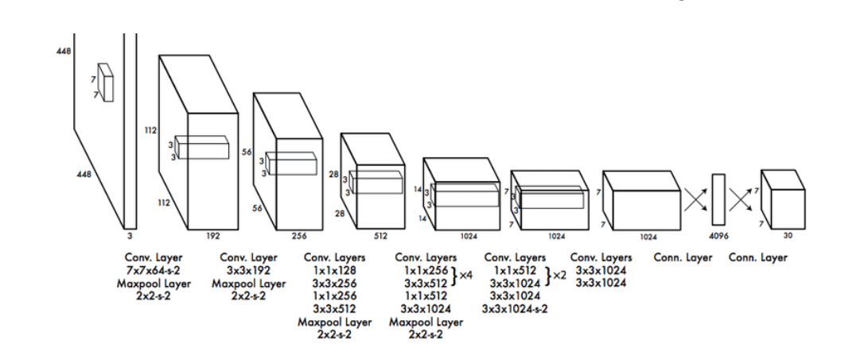
The Architecture of YOLO
Multajam, Rizki, et al. "Real-time detection and classification of fish in underwater environment using YOLOv5: a comparative study of deep learning architectures." Informatyka, Automatyka, Pomiary w Gospodarce i Ochronie Środowiska 14 (2024).

Slide 37
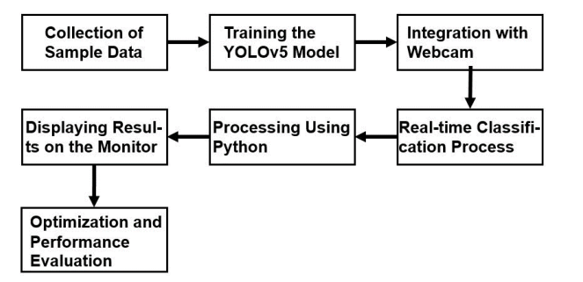
Illustration of a classification system
Multajam, Rizki, et al. "Real-time detection and classification of fish in underwater environment using YOLOv5: a comparative study of deep learning architectures." Informatyka, Automatyka, Pomiary w Gospodarce i Ochronie Środowiska 14 (2024).

Slide 38
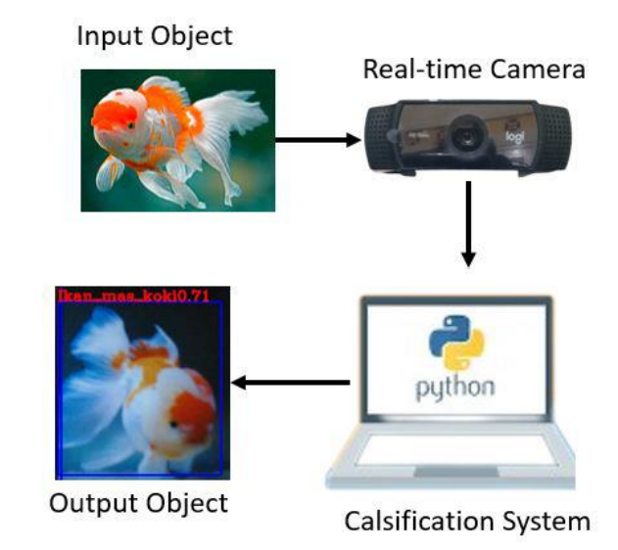
Implementation in real-time fish detection
Multajam, Rizki, et al. "Real-time detection and classification of fish in underwater environment using YOLOv5: a comparative study of deep learning architectures." Informatyka, Automatyka, Pomiary w Gospodarce i Ochronie Środowiska 14 (2024).

Slide 39
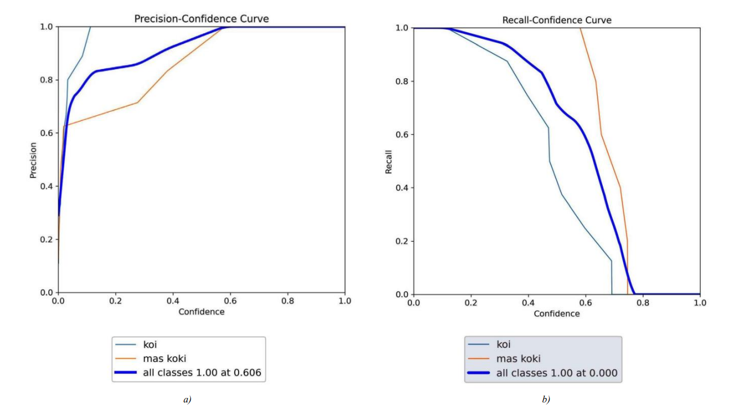
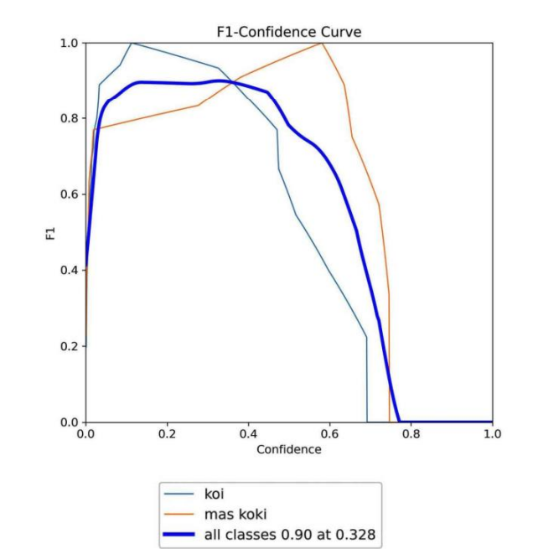
YOLO v5- The precision and recall graph of goldfish and koi: a – precision curve, b – recall curve , F1- Score
Multajam, Rizki, et al. "Real-time detection and classification of fish in underwater environment using YOLOv5: a comparative study of deep learning architectures." Informatyka, Automatyka, Pomiary w Gospodarce i Ochronie Środowiska 14 (2024).

Slide 40
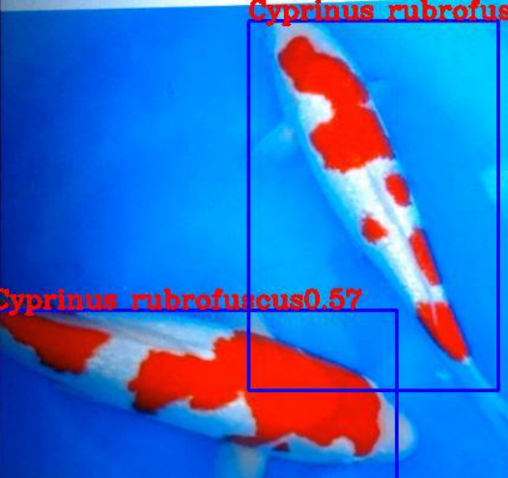
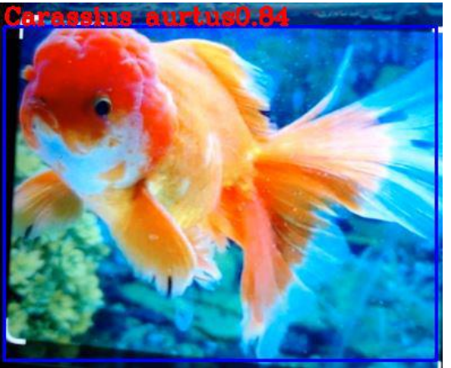
Classification results of Koi fish Cyprinus rubrofuscus)
Classification results of Golden fish (Carassius auratus)
Multajam, Rizki, et al. "Real-time detection and classification of fish in underwater environment using YOLOv5: a comparative study of deep learning architectures." Informatyka, Automatyka, Pomiary w Gospodarce i Ochronie Środowiska 14 (2024).

Slide 41
CHALLENGES
Knowing the datasets as YOLO need data to be converted to YOLO format
Understanding the Previous Works each with different datasets
Missing of proper code in resourceful sites like GitHub , Kaggle to implement existing models due to its updates
Identifying the updated need for object Detection by focusing on previous solution

Slide 42
CONCLUSION & FUTURE ENHANCEMENTS
Conclusion:
YOLO-Fish achieves state-of-the-art performance in underwater fish detection (~85% mAP@0.5).
Balances accuracy and speed for real-time applications while addressing environmental challenges.
Future Enhancements:
Integrate temporal modeling for large number of Images.
Explore semi-supervised learning to reduce annotation costs (~20–30%).
Optimize model further for edge deployment on low-power devices.

Slide 43
REFERENCES
Multajam, Rizki, et al. "Real-time detection and classification of fish in underwater environment using YOLOv5: a comparative study of deep learning architectures." Informatyka, Automatyka, Pomiary w Gospodarce i Ochronie Środowiska 14 (2024). – Goldfish,koi fish dataset with Random Samples
Saleh, Alzayat, Marcus Sheaves, and Mostafa Rahimi Azghadi. "Computer vision and deep learning for fish classification in underwater habitats: A survey." Fish and Fisheries 23.4 (2022): 977-999. - small size, moderate Size and Large sized including grey scale fish Dataset.
Al Muksit, Abdullah, et al. "YOLO-Fish: A robust fish detection model to detect fish in realistic underwater environment." Ecological Informatics 72 (2022): 101847. Deepfish dataset, Ozfish Dataset and Mixed Dataset. Yolo Fish-1 & Yolo Fish-2 models
https://github.com/alzayats/DeepFish
'https://github.com/ultralytics/ultralytics’ ;url: 'https://ultralytics.com

Slide 44

Thank You!!!

